Slide 1

1
GUARDIAN ANGEL ON THE ROAD
A SMART ACCIDENT DETECTION AND RECOVERY NOTIFICATION SOLUTION
Presented by
TEAM MEMBERS - BATCH 02
R . PREETHI - 410121243042
A .SARMILA - 410121243052
K . SHAGUFTHA - 410121243053
R . SUSHMA - 410121243057
Guided By :
L . MAHALAKSMI M.E.,

Slide 2
Table of content:
2
Abstract
Introduction
Literature review
Existing System
Problem statement
Scope of the Project
Objective
Proposed System
Algorithm and Technique
Flow chart
Architecture
Software and hardware requirements
Modules
Coding
Output/Result
Conclusion
Future Enhancement
References

Slide 3
3
ABSTRACT
Accident detection using computer vision has become a critical area in road safety, aiming to reduce response time and improve emergency management. This project, "Guardian Angel on the Road: A Smart Accident Detection and Recovery Notification Solution," introduces an advanced system for real-time accident detection through video surveillance. The framework utilizes axis bounding box techniques for precise object detection and a centroid-based Gaussian Mixture Model (GMM) for analyzing motion patterns in CCTV footage. This approach ensures high detection accuracy while minimizing false alarms. The system is tested under various environmental conditions, including daylight, low visibility, rain, hail, and snow, proving its robustness across diverse scenarios. Additionally, the project integrates Geopy to capture live location data and automatically notify the nearest police station and hospital with an accident snapshot. This enables authorities to allocate necessary resources efficiently, ensuring timely medical assistance. Furthermore, an alarm buzzer is included to alert nearby individuals, facilitating immediate intervention.
KEYWORDS : Axis bounding box , Centroid-based GMM , Machine Learning , Image processing , Video Analytics , Real-Time System.

Slide 4
4
INTRODUCTION
Road traffic accidents account for over 1.25 million deaths worldwide each year, with delayed response times being a significant factor in fatality rates. Traditional accident reporting relies on human intervention, which often leads to delays in medical assistance. The goal of this project is to develop a real-time, automated accident detection system that minimizes response time by instantly notifying emergency services.
To achieve this, the system integrates computer vision techniques with machine learning algorithms to monitor live traffic footage and identify accidents. It eliminates the need for manual reporting by automatically sending alerts and location data to authorities and nearby hospitals. This ensures that medical help reaches the accident site as quickly as possible.

Slide 5
5
LITERATURE SURVEY :
TITLE | AUTHOR | YEAR | DESCRIPTION
ACCIDENT PREVENTION, DETECTION AND REPORTING SYSTEM USING ARDUINO | Riya Dev, Sakshi Chaudhary, Abhishek Das | 2021 | The system is automatic, low cost and power efficient which makes it easy to install in vehicle. Unfortunately, if accident happens to take place, the system detects it and with the help of GPS exact location can be pointed and informed to emergency unit using GSM module. This helps to save many lives by informing rescuing agent in time.

Slide 6
6
TITLE | AUTHOR | YEAR | DESCRIPTION
ACCIDENT DETECTION AND ALERT SYSTEM | C K Gomathy | 2021 | This system aims to alert the nearby medical center about the accident to provide immediate medical aid. The attached accelerometer in the vehicle senses the tilt of the vehicle and the a heartbeat sensor on the user's body senses the abnormality of the heartbeat to understand the seriousness of the accident. Thus the systems will make the decision and sends the information to the smartphone, connected to the accelerometer through gsm and gps modules.

Slide 7
7
TITLE | AUTHOR | YEAR | DESCRIPTION
AI Enabled Accident Detection and Alert System Using IoT and Deep Learning for Smart Cities | Nikhlesh Pathik , Rajeev Kumar Gupta , Yatendra Sahu | 2021 | Ensemble transfer learning with dynamic weights is used to minimize the false detection rate. Due to the dataset’s unavailability, a personalized dataset is generated from the various videos available on the Internet. The proposed method is validated by a comparative analysis of ResNet and InceptionResnetV2. The experiment results show that InceptionResnetV2 provides a better performance compared to ResNet with training, validation, and a test accuracy of 89%,

Slide 8
8
EXISTING SYSTEM :
Objectives
Disadvantages
Collision Detection: Uses accelerometers to measure dynamic forces exceeding a predefined threshold.
Rollover Detection: Based on the vehicle’s inclination angle surpassing a threshold.
High dependency on sensors, making them costly and power-intensive.
Inefficient in cases where sensor failures occur.
Delays in accident detection and emergency response.
Machine Learning Models: Artificial Neural Networks (ANN), Support Vector Machines (SVM), and Random Forests (RF) are employed for crash prediction.

Slide 9
9
PROBLEM STATEMENT :
Timely accident detection is crucial for saving lives, but the existing methods rely on witnesses or drivers to report incidents, which can be unreliable and slow. This project aims to solve the following challenges:
Delayed emergency response due to manual accident reporting.
Inaccurate accident detection in existing systems.
Lack of automated geolocation tracking to guide emergency services.
Inability to detect accidents under different weather and lighting conditions.
By leveraging computer vision and real-time alerts, this project ensures that accidents are detected instantly and reported without human intervention.

Slide 10
10
SCOPE OF THE PROJECT :
The proposed system has wide-ranging applications and can be seamlessly integrated into smart city infrastructures for real-time accident detection and response. It is particularly beneficial for:
Urban traffic management systems to monitor and detect road accidents automatically.
Highways and expressways, where accidents often go unnoticed for long periods.
Public and private transportation networks, ensuring safer transit.
Surveillance-based road safety systems in developing cities.

Slide 11
11
OBJECTIVE :
The primary objective of this research is to reduce fatalities caused by
accidents by enabling timely detection and response.
The system detects accidents using image and video processing techniques
and promptly notifies nearby hospitals for resource arrangements.
By leveraging CCTV surveillance, it minimizes delays in emergency
response and improves communication between hospitals and accident sites.

Slide 12
12
PROPOSED SYSTEM
The proposed system enhances accident detection by utilizing image and video-based feature
extraction , eliminating the need for additional hardware sensors. Key features include:
Accident Detection via CCTV Surveillance: Identifies accidents in real-time from surveillance
footage.
Severity-Based Alert System: Determines whether the injury is minor or severe and sends
appropriate emergency alerts to nearby hospitals.
Improved Communication: Reduces response time by streamlining communication
between accident sites and hospitals.

Slide 13
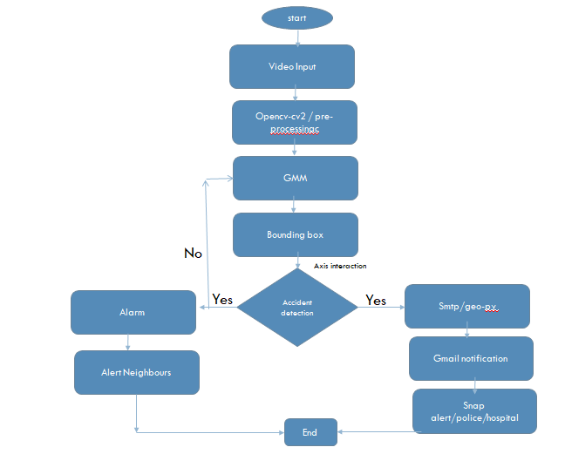
14
FLOW CHART :

Slide 14
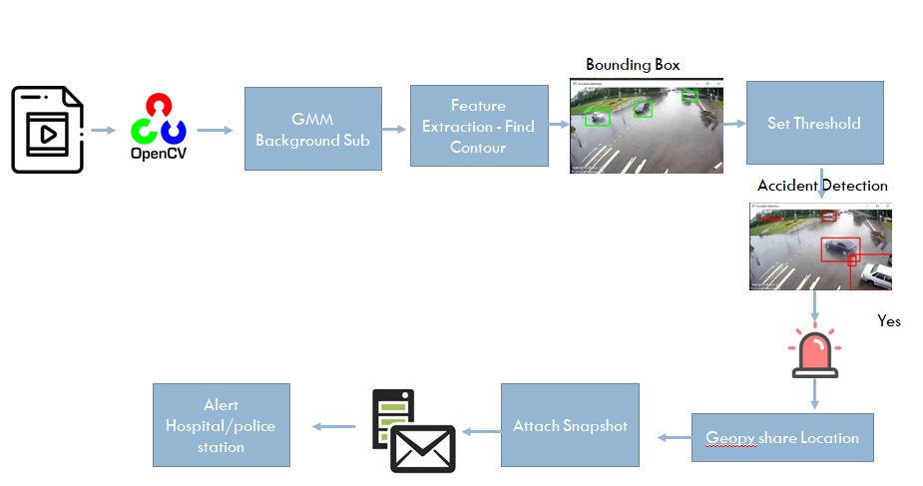
15
ARCHITECTURE :

Slide 15
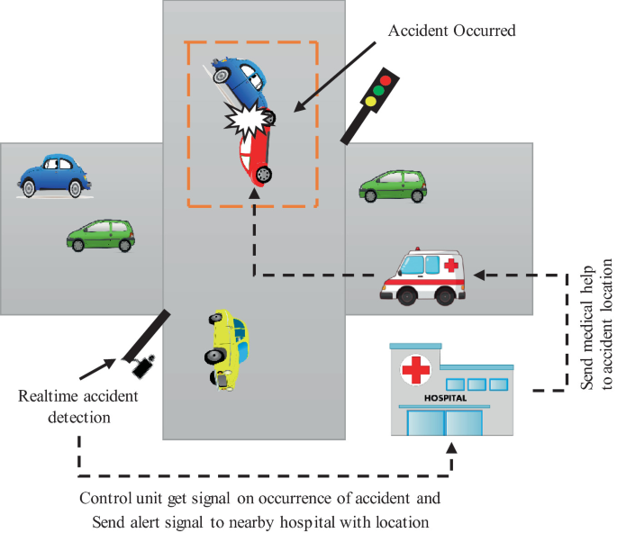
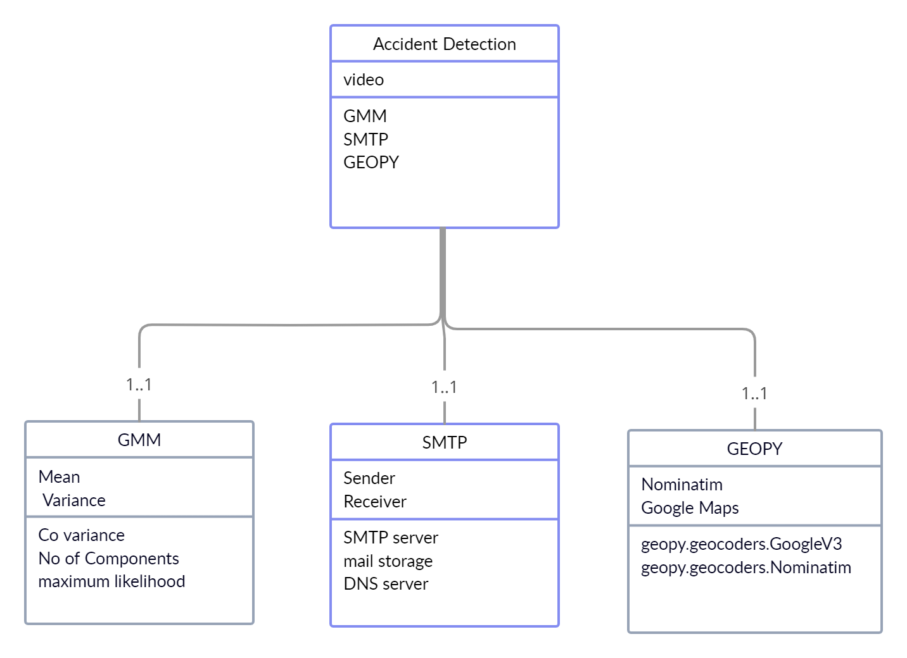

16

Slide 16
17
REQUIREMENT SPECIFICATIONS :
HARDWARE | SOFTWARE
Computer or Server: Powerful CPU, GPU (NVIDIA recommended), and at least 16GB RAM. | Operating System: Windows 7 above
Storage: SSD storage for data handling. | Language: Python
Camera and Capture Devices: High-quality surveillance cameras. | Tool: PyCharm
Network Connectivity: Stable high-speed internet. | Library:Python (version 3.6.5)
Power Supply: UPS or backup power sources. | Keras (version 2.1.6) TensorFlow (version 1.7.0)

Slide 17
18
MODULES :
1.Input Modules:
The system processes video input from CCTV cameras installed on highways or
accident-prone areas.
OpenCV is used to read the video, capturing frames for further analysis.
The video feed is continuously monitored for detecting potential accidents.
.

Slide 18
2. Background Learning Modules:
This module distinguishes between the static background and moving foreground objects in the video feed.
It extracts frames and applies the Mixture of Gaussians (MOG) algorithm to model background pixels.
OpenCV’s cv2.createBackgroundSubtractorMOG() function is used to filter background elements and detect
motion effectively

Slide 19
3. Foreground Extraction Module:
This module isolates moving objects using background subtraction techniques.
Background Subtraction: Identifies foreground objects by removing static pixels.
Image Enhancement: Noise filtering, dilation, and erosion techniques refine object contours.
Foreground Extraction: Clearly identifies moving vehicles and potential accident scenarios.

Slide 20
19
4. Accident Detection Module:
The system analyzes extracted foreground objects and applies contour-based feature extraction.
Bounding boxes are drawn around moving vehicles. When two bounding boxes overlap or collide, the system detects a potential accident.
The collision detection mechanism determines whether the event is an accident or normal vehicle movement.

Slide 21
13
ALGORITHM AND TECHNIQUE :
Axis-Aligned Bounding Box (AABB) Technique: Draws rectangular bounding boxes around detected objects for efficient object detection.
Centroid-Based Gaussian Mixture Model (GMM) Algorithm: Analyzes surveillance footage by modeling object movement patterns, distinguishing normal traffic from anomalies such as accidents.
This approach ensures a more effective, sensor-independent accident detection system with faster emergency response, ultimately reducing fatalities.

Slide 22

33

Slide 23
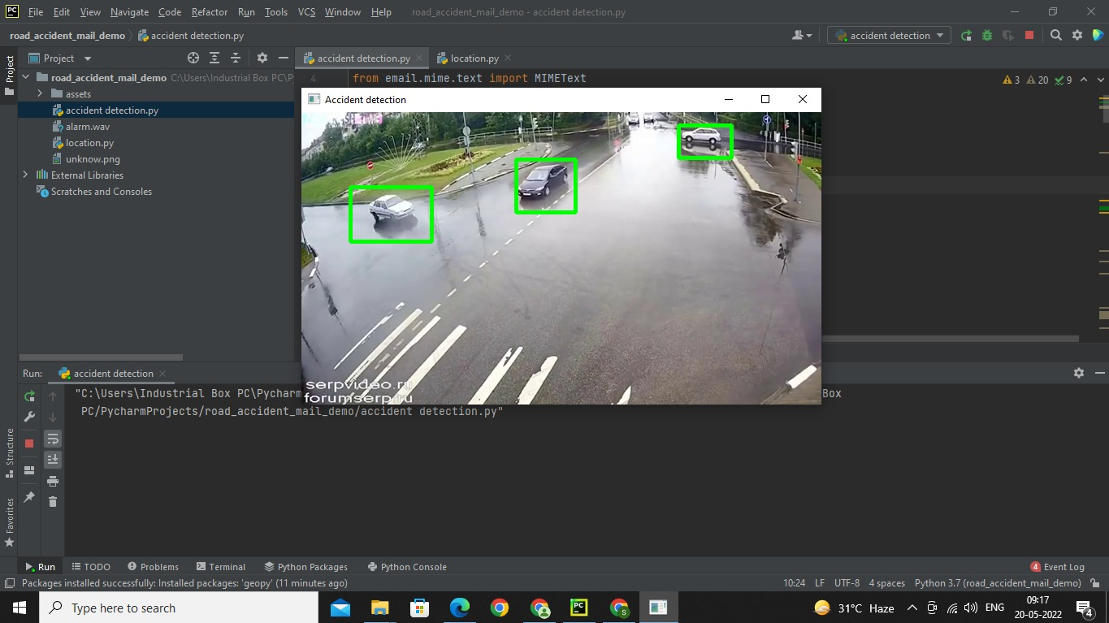
OUTPUT:
34

Slide 24
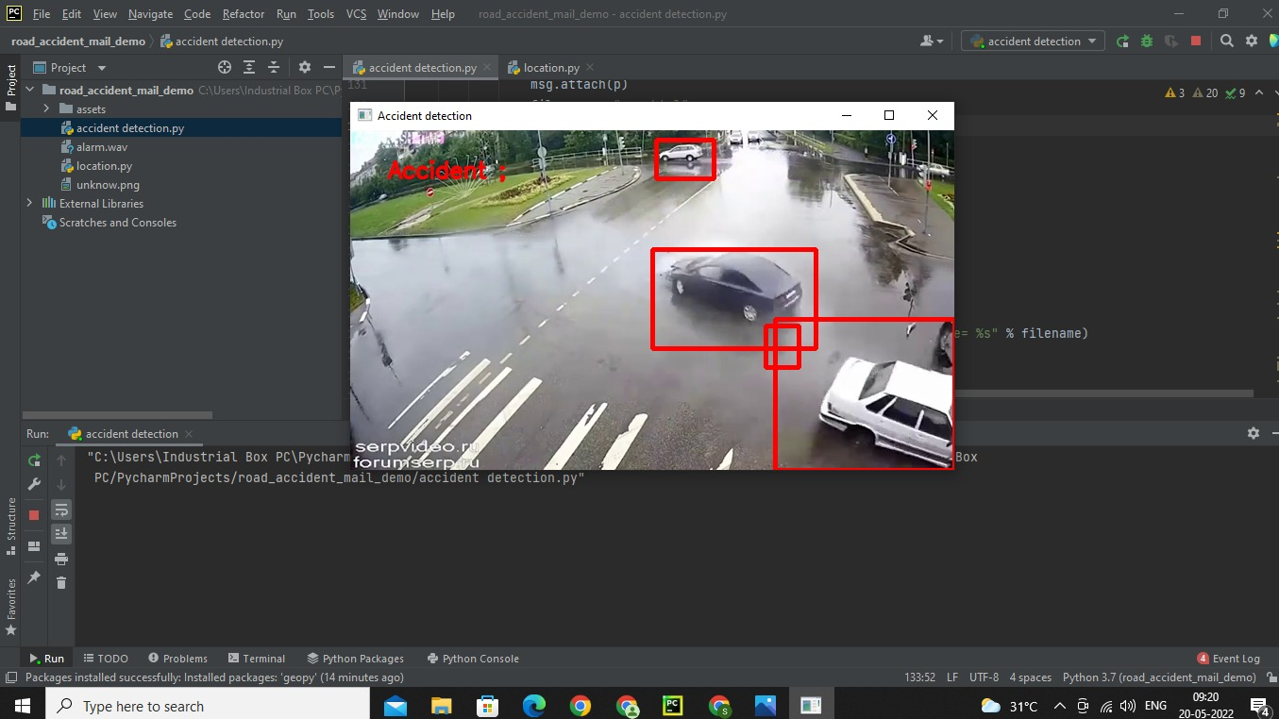
35

Slide 25
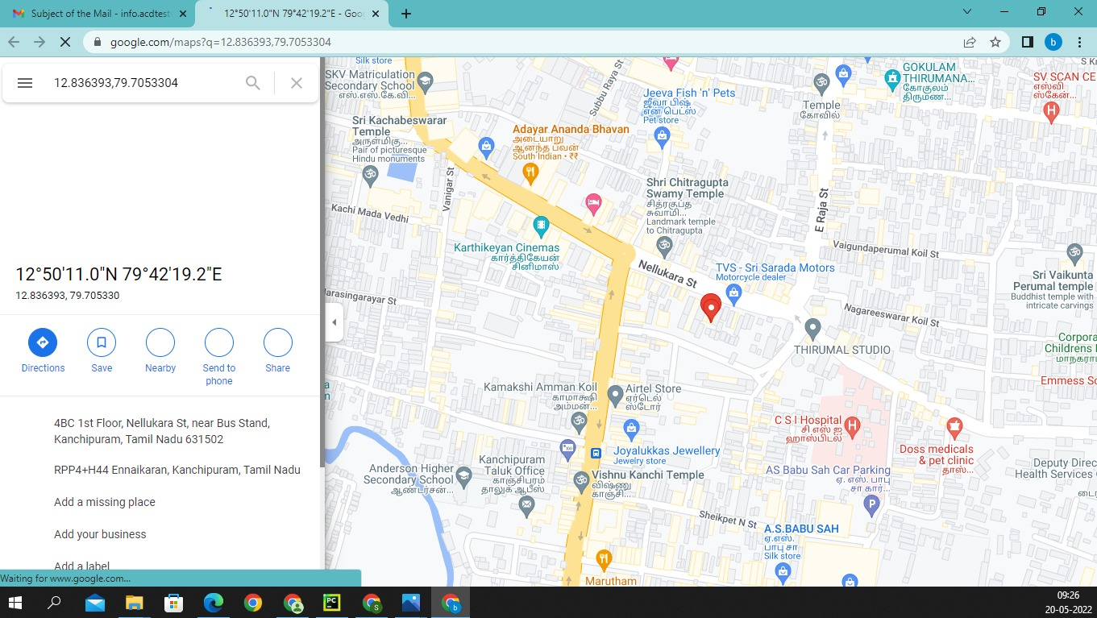
36

Slide 26

37

Slide 27
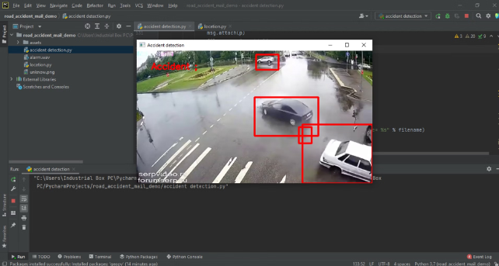
38
CONCLUSION:
The proposed accident detection system is implemented using Python and OpenCV, analyzing traffic camera footage from various sources. The system applies image processing techniques to detect accidents after selecting a region of interest (ROI). Currently, the system works with pre-recorded video. Our project accuracy is 92%. This approach significantly reduces emergency response time, helping to save lives.

Slide 28
39
FUTURE ENHANCEMENT:
Predictive Accident Analysis – Training machine learning models on historical data to predict high-risk accident zones and prevent collisions.
IoT-Based Real-Time Alerts – Integrating IoT sensors to automatically send accident alerts to hospitals, police, and emergency services.
Integration with Emergency Services – Connecting the system with ambulance dispatch and local authorities for faster response times.
Camera Calibration Techniques: Using lane detection and calibration can improve system performance under varying camera angles.

Slide 29
40
REFERENCES:
[1] Rajvardhan Rishi, Sofiya Yede, Keshav Kunal, Nutan V. Bansode,” Automatic Messaging System for Vehicle Tracking and Accident Detection, Proceedings of the International Conference on Electronics and Sustainable Communication Systems,ICESC, 2020
[2] Mr S.Kailasam, Mr Karthiga, Dr Kartheeban, R.M.Priyadarshani, K.Anithadevi, “Accident Alert System using face Recognition”,IEEE, 2019
[3] Bharath P, Saravanan M, Aravindhan K,” Literature Survey on Smart Vehicle Accident Prediction Using Machine Learning Algorithm “, 2019
[4] T Kalyani, S Monika, B Naresh, Mahendra Vucha, “Accident Detection and Alert System”,
[5] Aarya D.S, Athulya C.K, Anas.P, Basil Kuriakose, Jerin Susan Joy , Leena Thomas, “Accident Alert and Tracking Using Arduino”, International Journal of Advanced Research in Electrical, Electronics and Instrumentation Engineering, Vol. 7, Issue 4, April
[6] Nagarjuna R Vatti, PrasannaLakshmi Vatti, Rambabu Vatti, Chandrashekhar Garde, “Smart Road Accident Detection and communication System”, 8 IEEE International Conference on Current Trends toward Converging Technologies, Coimbatore, India, 2018
[7] Wen-Kai Tai*, Hao-Cheng Wang, Cheng-Yu Chiang, Chin-Yueh Chien, Kevin Lai, and TsengChang Huang,” RTAIS: Road Traffic Accident Information System”, 20th International Conference on High Performance Computing and Communications, 2018

Slide 30
[8] Miss. Priyanka M. Sankpal, Prof. P. P. More “Accident Avoidance System Using IR Transmitter “, IJRASET, Volume 5 Issue IV, April
[9] Usman Khalil, Tariq Javid, Adnan Nasir, “Automatic road accident detection techniques: A brief survey”, in proceedings of IEEE Symposium on-Wireless Systems and Networks (ISWSN), 2017, 19- 22 Nov. 2017, Lahore, Pakistan
[11] Harit Sharma, Ravi Kanth Reddy, Archana Karthik, “S-CarCrash: Real-time Crash Detection Analysis and Emergency Alert using Smartphone “, ICCVE, 2016
[12] sPrashant Kapri, Shubham Patane, Arul Shalom A, “Accident Detection & Alert System”, IEEE, 2018 Bruno Fernandes, Vitor Gomes, Joaquim Ferreira and Arnaldo Oliveira, “Mobile Application for Automatic Accident Detection and Multimodal Alert”, IEEE, 2015
[13] Adnan Bin Faiz, Ahmed Imteaj, Mahfuzulhoq Chowdhury, “Smart Vehicle Accident Detection and Alarming System Using a Smartphone”, International Conference on Computer & Information Engineering, 2015
[14] Manuel Fogue, Piedad Garrido, Francisco J. Martinez,”A System for Automatic Notification and Severity Estimation of Automotive Accidents”, IEEE, 2014
[15] Hossam M. Sherif, Hossam M. Sherif, Samah A. Senbel, “Real Time Traffic Accident Detection System using Wireless Sensor Network”, International Conference of Soft Computing and Pattern Recognition, 2014

Slide 31
41
THANK YOU

